Slide 1

Master Thesis - Presentation
  In-Train Positioning System

Slide 2
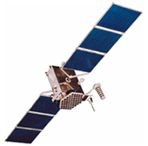
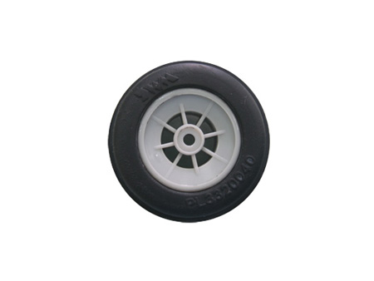
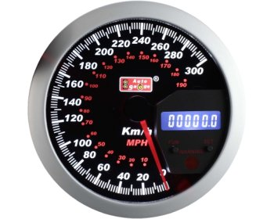
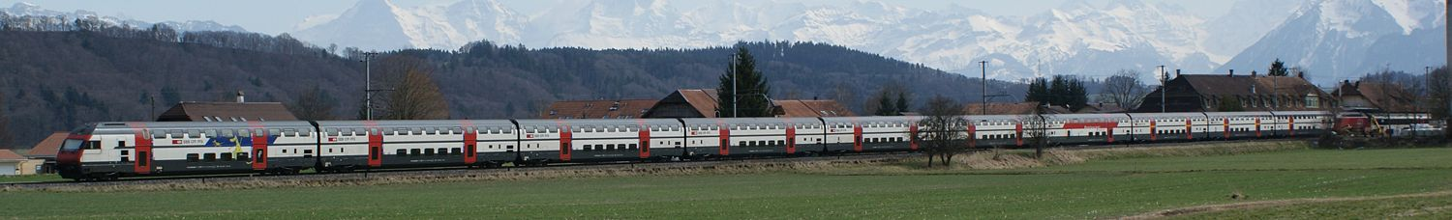
Problem
Positioning in the passenger compartment
inside train vehicles is difficult
Bad and intermittent GPS reception,
especially in stations and in tunnels
No wheel sensors (odometer)‏
No speed sensor
...

Slide 3




Solution
A multi-sensor positioning system using:
Very sensitive GPS
inertial navigation system
User-input via GUI
A database of track waypoints
Geo-located WiFi Access Points

Slide 4
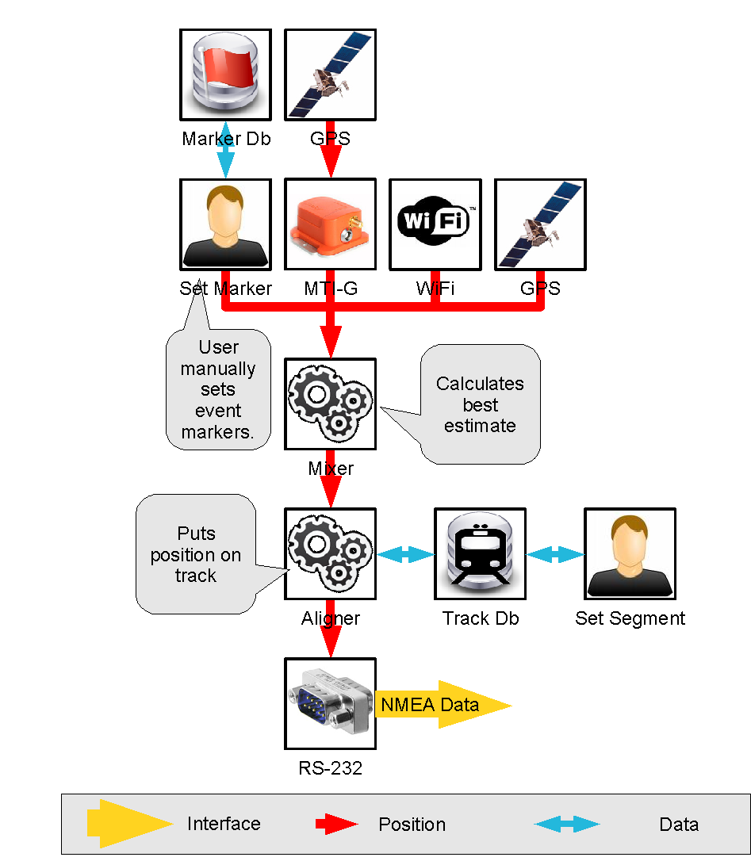
Archi- tecture

Slide 5
Thank you.

